Slide 1
Opening/Closing Rail Car Plug and Sliding Doors
Training Objectives
  Instruct clamp drivers on the proper procedure to open and close freight car plug and sliding door types to prevent injury by the door operating assembly
  Inspection procedures to recognize potential hazards which could result in a door falling and striking an employee
  Unseal/resealing doors safely while in the line of fire or RED ZONE

Slide 2
Door Types and Red Zones
Red Zones
RED ZONE
RED ZONE
Plug Doors
Sliding Doors

Slide 3
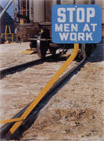
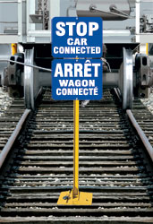
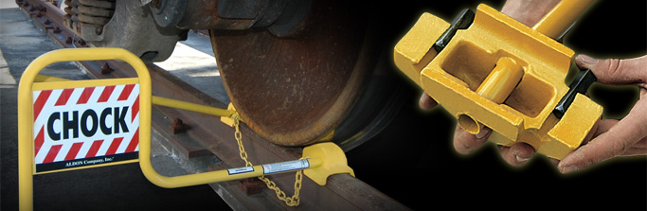
Blue Flag & Rail Chocks
Ensure Blue Flag is in place to alert rail company
Rail wheel chocked to prevent “pulling” by rail company when in use

Slide 4
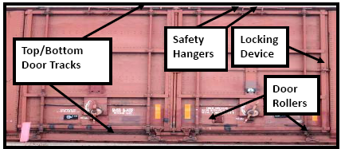
Inspection of Rail Car Doors for Defects
Be aware of the RED ZONE
Secure PIT and position body to the right or left of the plug door. Defects to look for:
  Debris in bottom door track
  Bulging doors
  Defective bottom rollers
  Rust and/or bent tracks at top and bottom
  Handles, levers or crank assembly bent or fractured
  Door stop not in place
  Repair signage on door
If door is defective or damaged; or if you are unsure of its condition; or the door cannot be opened safely, DO NOT ATTEMPT TO OPEN THE DOOR. Contact your supervisor and carrier for assistance.
Submit an Arrival Condition Report (ACR) to mill for complaints.

Slide 5
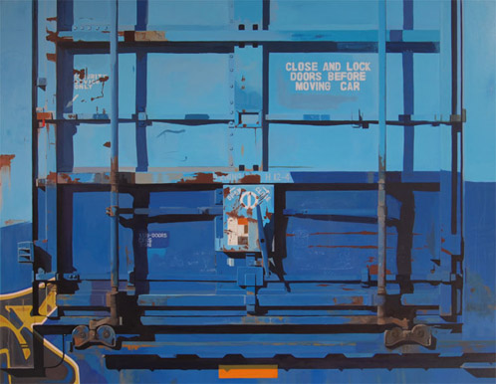
Operating rods for locking pins
Inspect condition, look for damage
Operating Crank
-Is it in Good Condition?
-Is it Damaged?
Operating Rods
-Are they Bent?
-Are they Damaged?

Slide 6
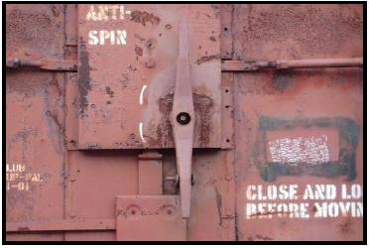
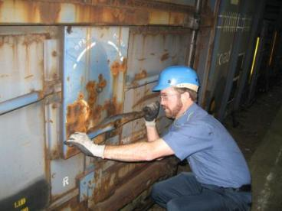
Plug Door Open/Close
Check plug door handle for bulging or excessive tension due to possible load shifting. This may cause handle to spin, hitting arm or hand.
Use a 5# dead blow hammer to tap handle to release initial tension.
  Dead blow hammer will not result in deflection or bounce back.
  Be prepared to drop the hammer or release the handle and move away if the handle begins to spin or jump outward when tension is released.
If there is still pressure, tap the mechanism again to release. If extensive tension continues or door bulges, contact supervisor and carrier.
Once tension is released, open door approximately 2 ft. to check inside car for roll stability.

Slide 7
Plug Door Open/Close
Unseal plug door by turning handle counter clock wise
Use proper body position, and ensure you have secure footing while turning
Turn handle smoothly
  Apply equal pressure
  Do Not Jerk
Place hands and thumbs on outside of door handle while unsealing door

Slide 8
Sliding Door Open/Close
Check door latch for tension or bulging for possible shifting causing door latch and or door to be hard to open
If excessive force is required to open, STOP and contact your supervisor and carrier.
Unseal by unlatching door
Use proper body position and secure footing. DO NOT JERK
Place hands and thumbs on outside of door latch to avoid pinch points while unsealing door.
Open door approximately 2 ft to check roll positioning inside car for stability.

Slide 9
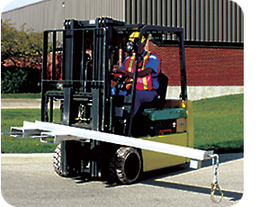
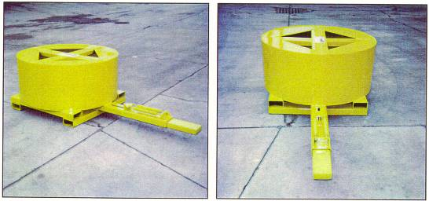
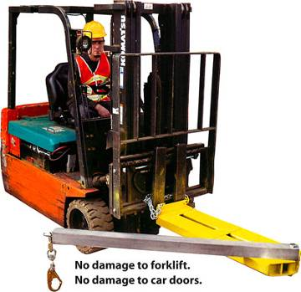
Opening/Closing the Rail Car Door
  Use proper rail car door opening device. Shown below are recommended types
  Avoid using chains, straps or a come along due to the possibility of snapping
  Avoid using forks or clamp jaws directly on door which could cause damage, force door off tracks and create burrs on the clamp jaws resulting in paper damage.
  Do not physically open doors

Slide 10
Removing Packing Material from Doorway
Place PIT parallel to railcar door or place roll stock next to the open door while removing packing material from doorway. Doors may disengage from rail track unexpectedly. This aid in protection from a possible falling door.

Slide 11
Freight Car Plug and Sliding Door Open/Close Summary
Inspect railcar doors to ensure they are in good working order. Ensure door rail guides are not damaged with stops at both ends.
Report railcars suspected of damage or unsafe to your supervisor including damage done during unloading. Report rejected cars immediately to mill using the Arrival Condition Report (ACR).
Open railcar doors only in areas where a forklift can be positioned in front of the door as protection against possible falling doors.
Never face railcar doors as they open. Keep your eyes on the doors until doors come to a complete and secure stop.

Slide 12
Freight Car Plug and Sliding Door Open/Close Summary
Inspecting for door defects and extensive pressure build up can provide a SAFE method of injury prevention.
Only use recommended tooling to open/close car doors. Avoid using chains, straps, come alongs or manually opening doors with the forks or clamp.
When opening and closing doors, ensure pedestrians are not within the RED ZONE

